Slide 1
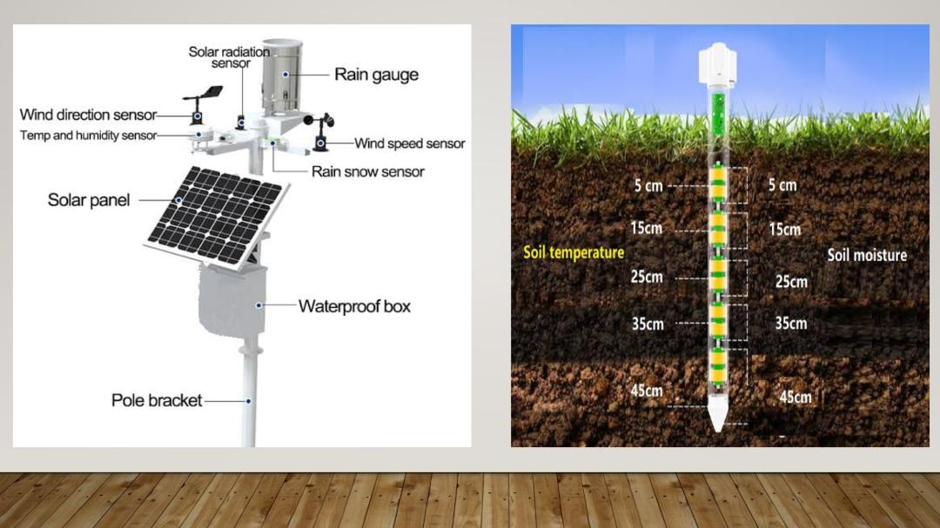

Slide 2
Mechanism
This is the whole mechanism of our device
- These two seasons are for measuring wind speed and wind directions and this sensor is for temperature and humidity
- And the next is very important parts of the device that is multi spectrum AI cameras to detect fungus and different types of plant disease
- And the other important part is soil spike which detects soil fertility , moisture and temperature
- These all sensors are powered by a very energy efficient solar plant
- But in case of cloudy weather there is a battery to supply power for upto 10 hours
» next my team partner mayank will tell you advantages of our invention

